Slide 1




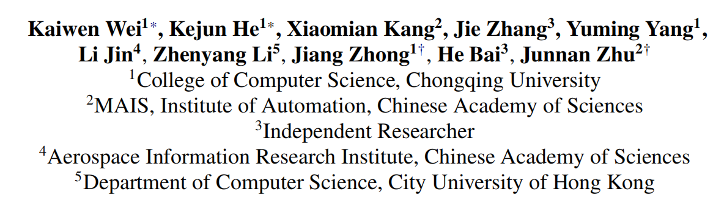



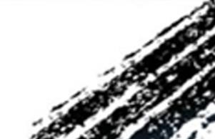

ATAI
Advanced Technique of Artificial Intelligence
ATAI
ChongqingUniversity _{AdvancedTechniqueof}
of Technology Artificial Intelligence
Chongqing University of
Technology
Chongqing University ^{ATAI}
_{of Technology} Advanced Techniqueof
Artificial Intelligence
Chongqing University of Technology
Chongqing University of Technology
From Past To Path: Masked History Learning for
Next-Item Prediction in Generative Recommendation
code: https://github.com/CQU-MM-Intelligent-Lab/MHL
——ACL_2026
Reported by Xiaomin Zhao
1

Slide 2
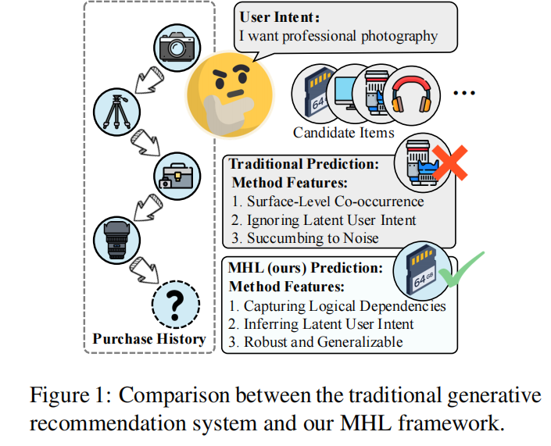
ATAI
Advanced Technique of Artificial Intelligence
ATAI
ChongqingUniversity _{AdvancedTechniqueof}
of Technology Artificial Intelligence
Chongqing University of
Technology
Chongqing University ^{ATAI}
_{of Technology} Advanced Techniqueof
Artificial Intelligence
Chongqing University of Technology
Chongqing University of Technology
Motivation
1.Existing generative recommendation methods overwhelmingly rely on a left-to-right autoregressive paradigm, introducing an inherent limitation: short-term myopia. Models easily overfit to surface-level co-occurrences or recent interactions, failing to capture underlying intent.
2.By compelling the model to reconstruct masked tokens within past interactions, we force it to model global dependencies across the entire sequence rather than relying strictly on immediate local context.
Notes:
同质图：节点都是一种类型，例如“用户”。边也是一种类型， “交互”。U-I图其实就是异构图

Slide 3
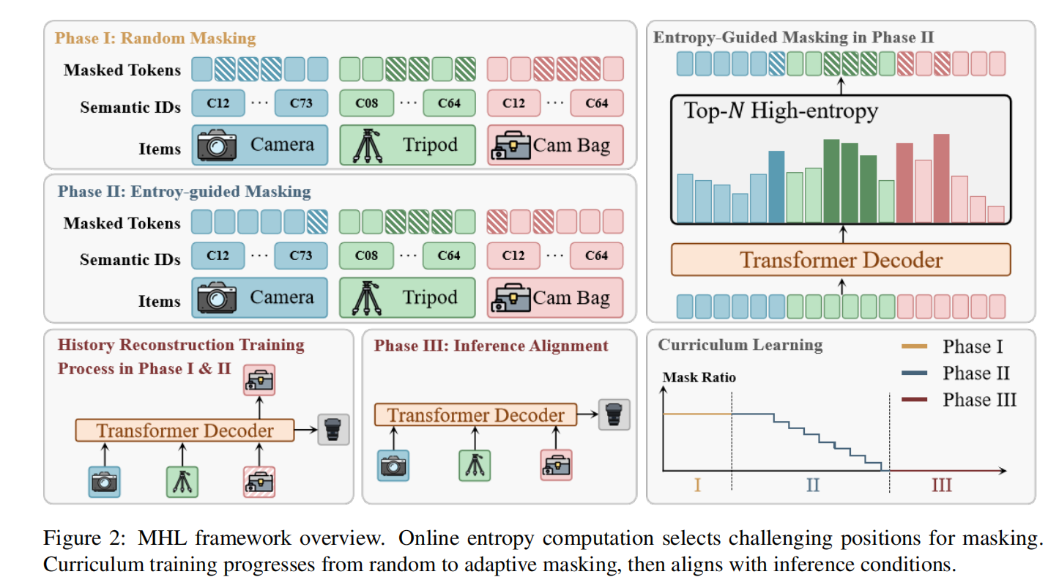
ATAI
Advanced Technique of Artificial Intelligence
ATAI
ChongqingUniversity _{AdvancedTechniqueof}
of Technology Artificial Intelligence
Chongqing University of
Technology
Chongqing University ^{ATAI}
_{of Technology} Advanced Techniqueof
Artificial Intelligence
Chongqing University of Technology
Chongqing University of Technology
Method
Figure 2: The overall framework of the proposed CPT-GDA.
Notes:
同质图：节点都是一种类型，例如“用户”。边也是一种类型， “交互”。U-I图其实就是异构图

Slide 4
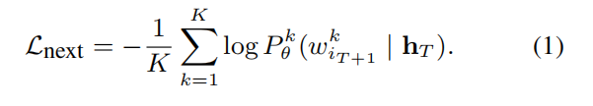
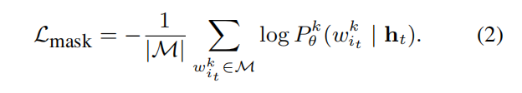

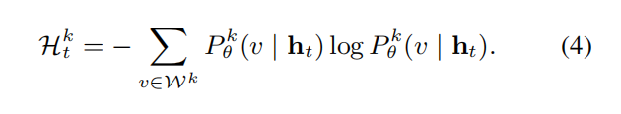

ATAI
Advanced Technique of Artificial Intelligence
ATAI
ChongqingUniversity _{AdvancedTechniqueof}
of Technology Artificial Intelligence
Chongqing University of
Technology
Chongqing University ^{ATAI}
_{of Technology} Advanced Techniqueof
Artificial Intelligence
Chongqing University of Technology
Chongqing University of Technology
Method

Slide 5

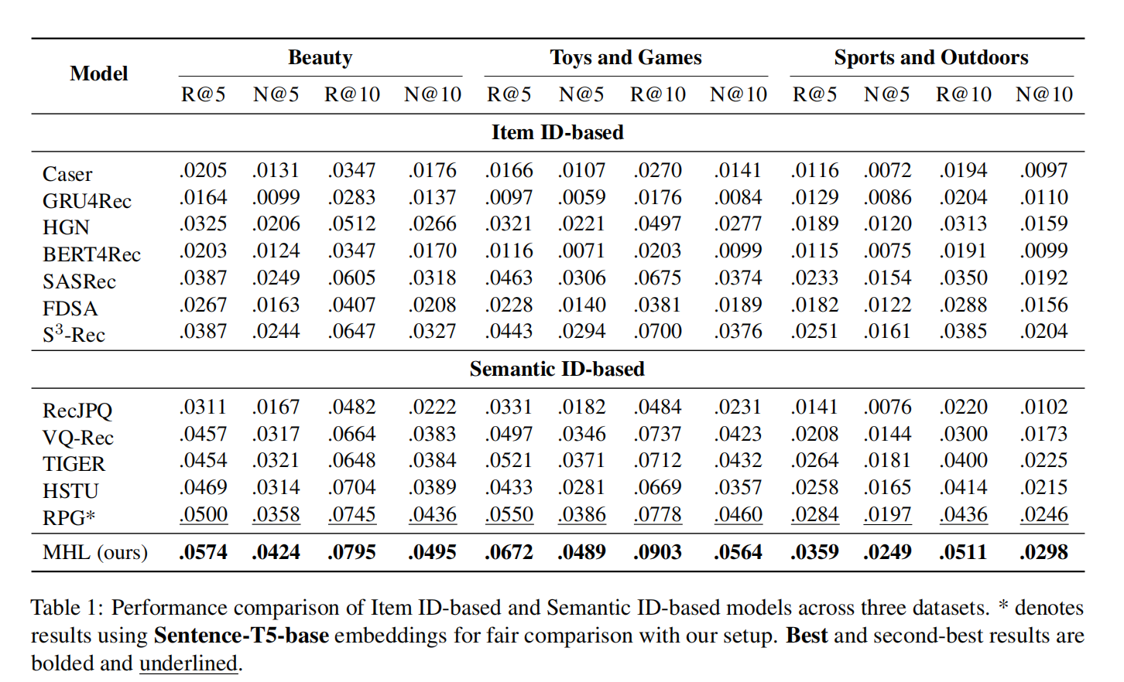
ATAI
Advanced Technique of Artificial Intelligence
ATAI
ChongqingUniversity _{AdvancedTechniqueof}
of Technology Artificial Intelligence
Chongqing University of
Technology
Chongqing University ^{ATAI}
_{of Technology} Advanced Techniqueof
Artificial Intelligence
Chongqing University of Technology
Chongqing University of Technology

Slide 6
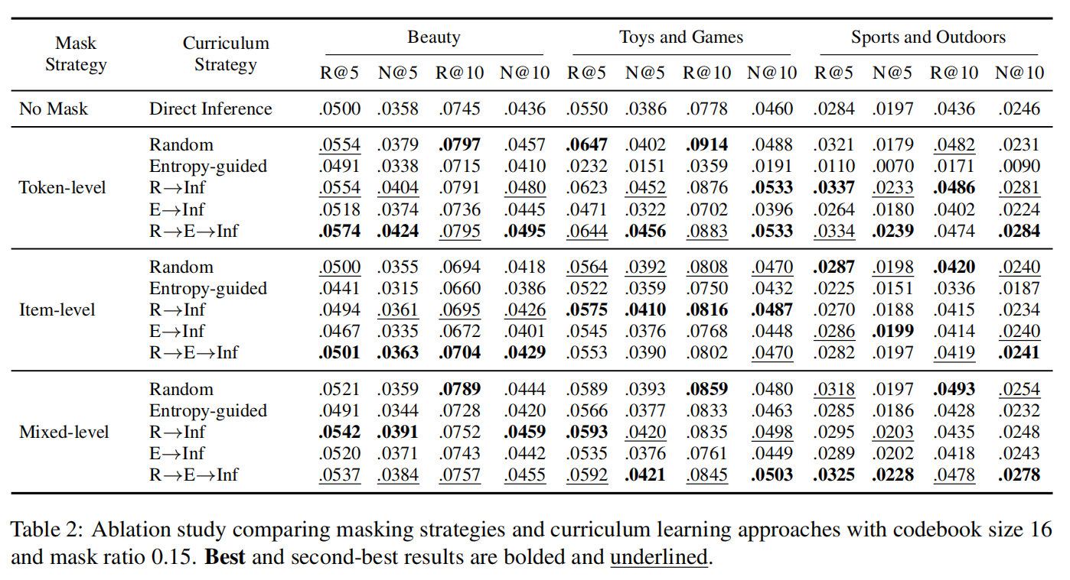
ATAI
Advanced Technique of Artificial Intelligence
ATAI
ChongqingUniversity _{AdvancedTechniqueof}
of Technology Artificial Intelligence
Chongqing University of
Technology
Chongqing University ^{ATAI}
_{of Technology} Advanced Techniqueof
Artificial Intelligence
Chongqing University of Technology
Chongqing University of Technology

Slide 7


ATAI
Advanced Technique of Artificial Intelligence
ATAI
ChongqingUniversity _{AdvancedTechniqueof}
of Technology Artificial Intelligence
Chongqing University of
Technology
Chongqing University ^{ATAI}
_{of Technology} Advanced Techniqueof
Artificial Intelligence
Chongqing University of Technology
Chongqing University of Technology
Thanks!

